Slide 1


PROJECT REPORT
ON
“Integrated Common Services to Common People”
is submitted to
Intel Unnati Industrial Training 2024
Prof. Ram Meghe Institute of Technology and Research, Badnera, Amravati.
By
Mr. Sujal Guhe Ms. Mrunali Yawale
Ms. Samiksha More
Under the Guidance of: Intel Industry Mentor:
Dr. R. R. Karwa Mr. Debdyut Hazra
Prof. A. U. Chaudhari
Prof. Ram Meghe Institute of Technology and Research, Badnera, Amravati.
(An Autonomous Institute & NAAC Accredited)
Sant Gadge Baba Amravati University, Amravati
2024-2025

Slide 2
Problem Statement
Challenges:
Vast amounts of healthcare information available online.
Difficulty in identifying reliable and trustworthy sources.
Consequences:
People waste time searching for the right services.
Delays in seeking necessary healthcare.
Potential for choosing unqualified providers.
Common people struggle to find:
Hospitals with specific specialties.
Costs and insurance coverage details for procedures.
Reliable elder care and nurse services.
Emergency services like ambulance or oxygen suppliers.
Nearby doctors with good ratings.

Slide 3
Unique Idea Brief (Solution)
Problem: Difficulty finding reliable healthcare information online.
Users: Common people & Healthcare providers.
Solution: Centralized Web-based Application for healthcare services.
Features:
  Search nearby doctors, hospitals, labs, etc.
  Ratings & reviews for providers.
  Emergency service location.
  Elder care & nurse listings.
  Service provider registration.
Benefits: Easy access, saves time, informed decisions, get all health services at one place
Scalable: Can expand features and services.
Focus: User-friendly for everyday people.
Cost estimates & insurance coverage.

Slide 4
Features Offered
The Integrated Health Hub is an Web-based Application with an user friendly user interface provides various features to the common people facing a lot of problems in day to day life regarding health problems. So this Application provides following features to reduces and maintain the health easily:
  To Book an online appointment with doctor.
  To find nearest lab services.
  To find nearest Hospitals.
  To find nearest Pharmacy.
  To find nearest Diagnostic center details.
  The user can search for nearest best hospital services, emergency services, etc.
  It gives cost details and health insurance coverage details.
  It provide Elder care and Nurse service contact details (nearest location)
  Manage Doctors, Hospitals, Lab services, Appointments, etc.

Slide 5
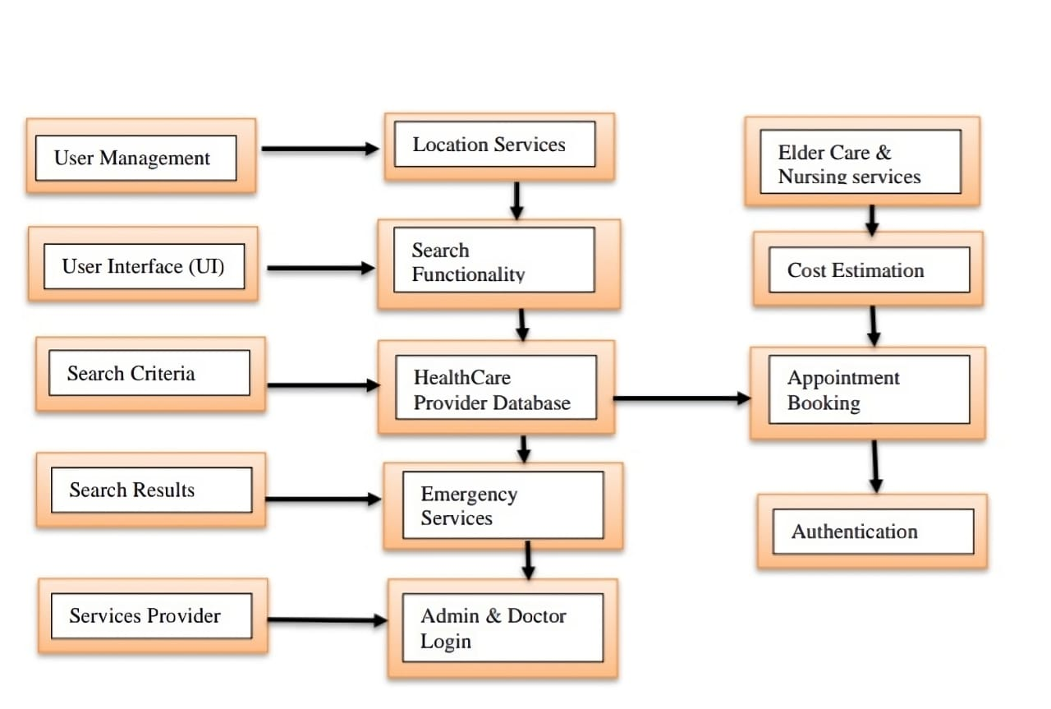
Process Flow
Fig 1. Process Flow

Slide 6
Users search healthcare services (doctors, hospitals) on a user-friendly app.
Application finds nearby providers based on location.
Users define search criteria like doctor specialty.
Application has secure login and user accounts.
Application searches a central database for providers.
Database stores info on doctors, hospitals, etc.
Users can see ratings and potentially costs.
Schedule appointments directly in app.
App provides emergency service contact info.
Doctors can register and add their info to the app.

Slide 7
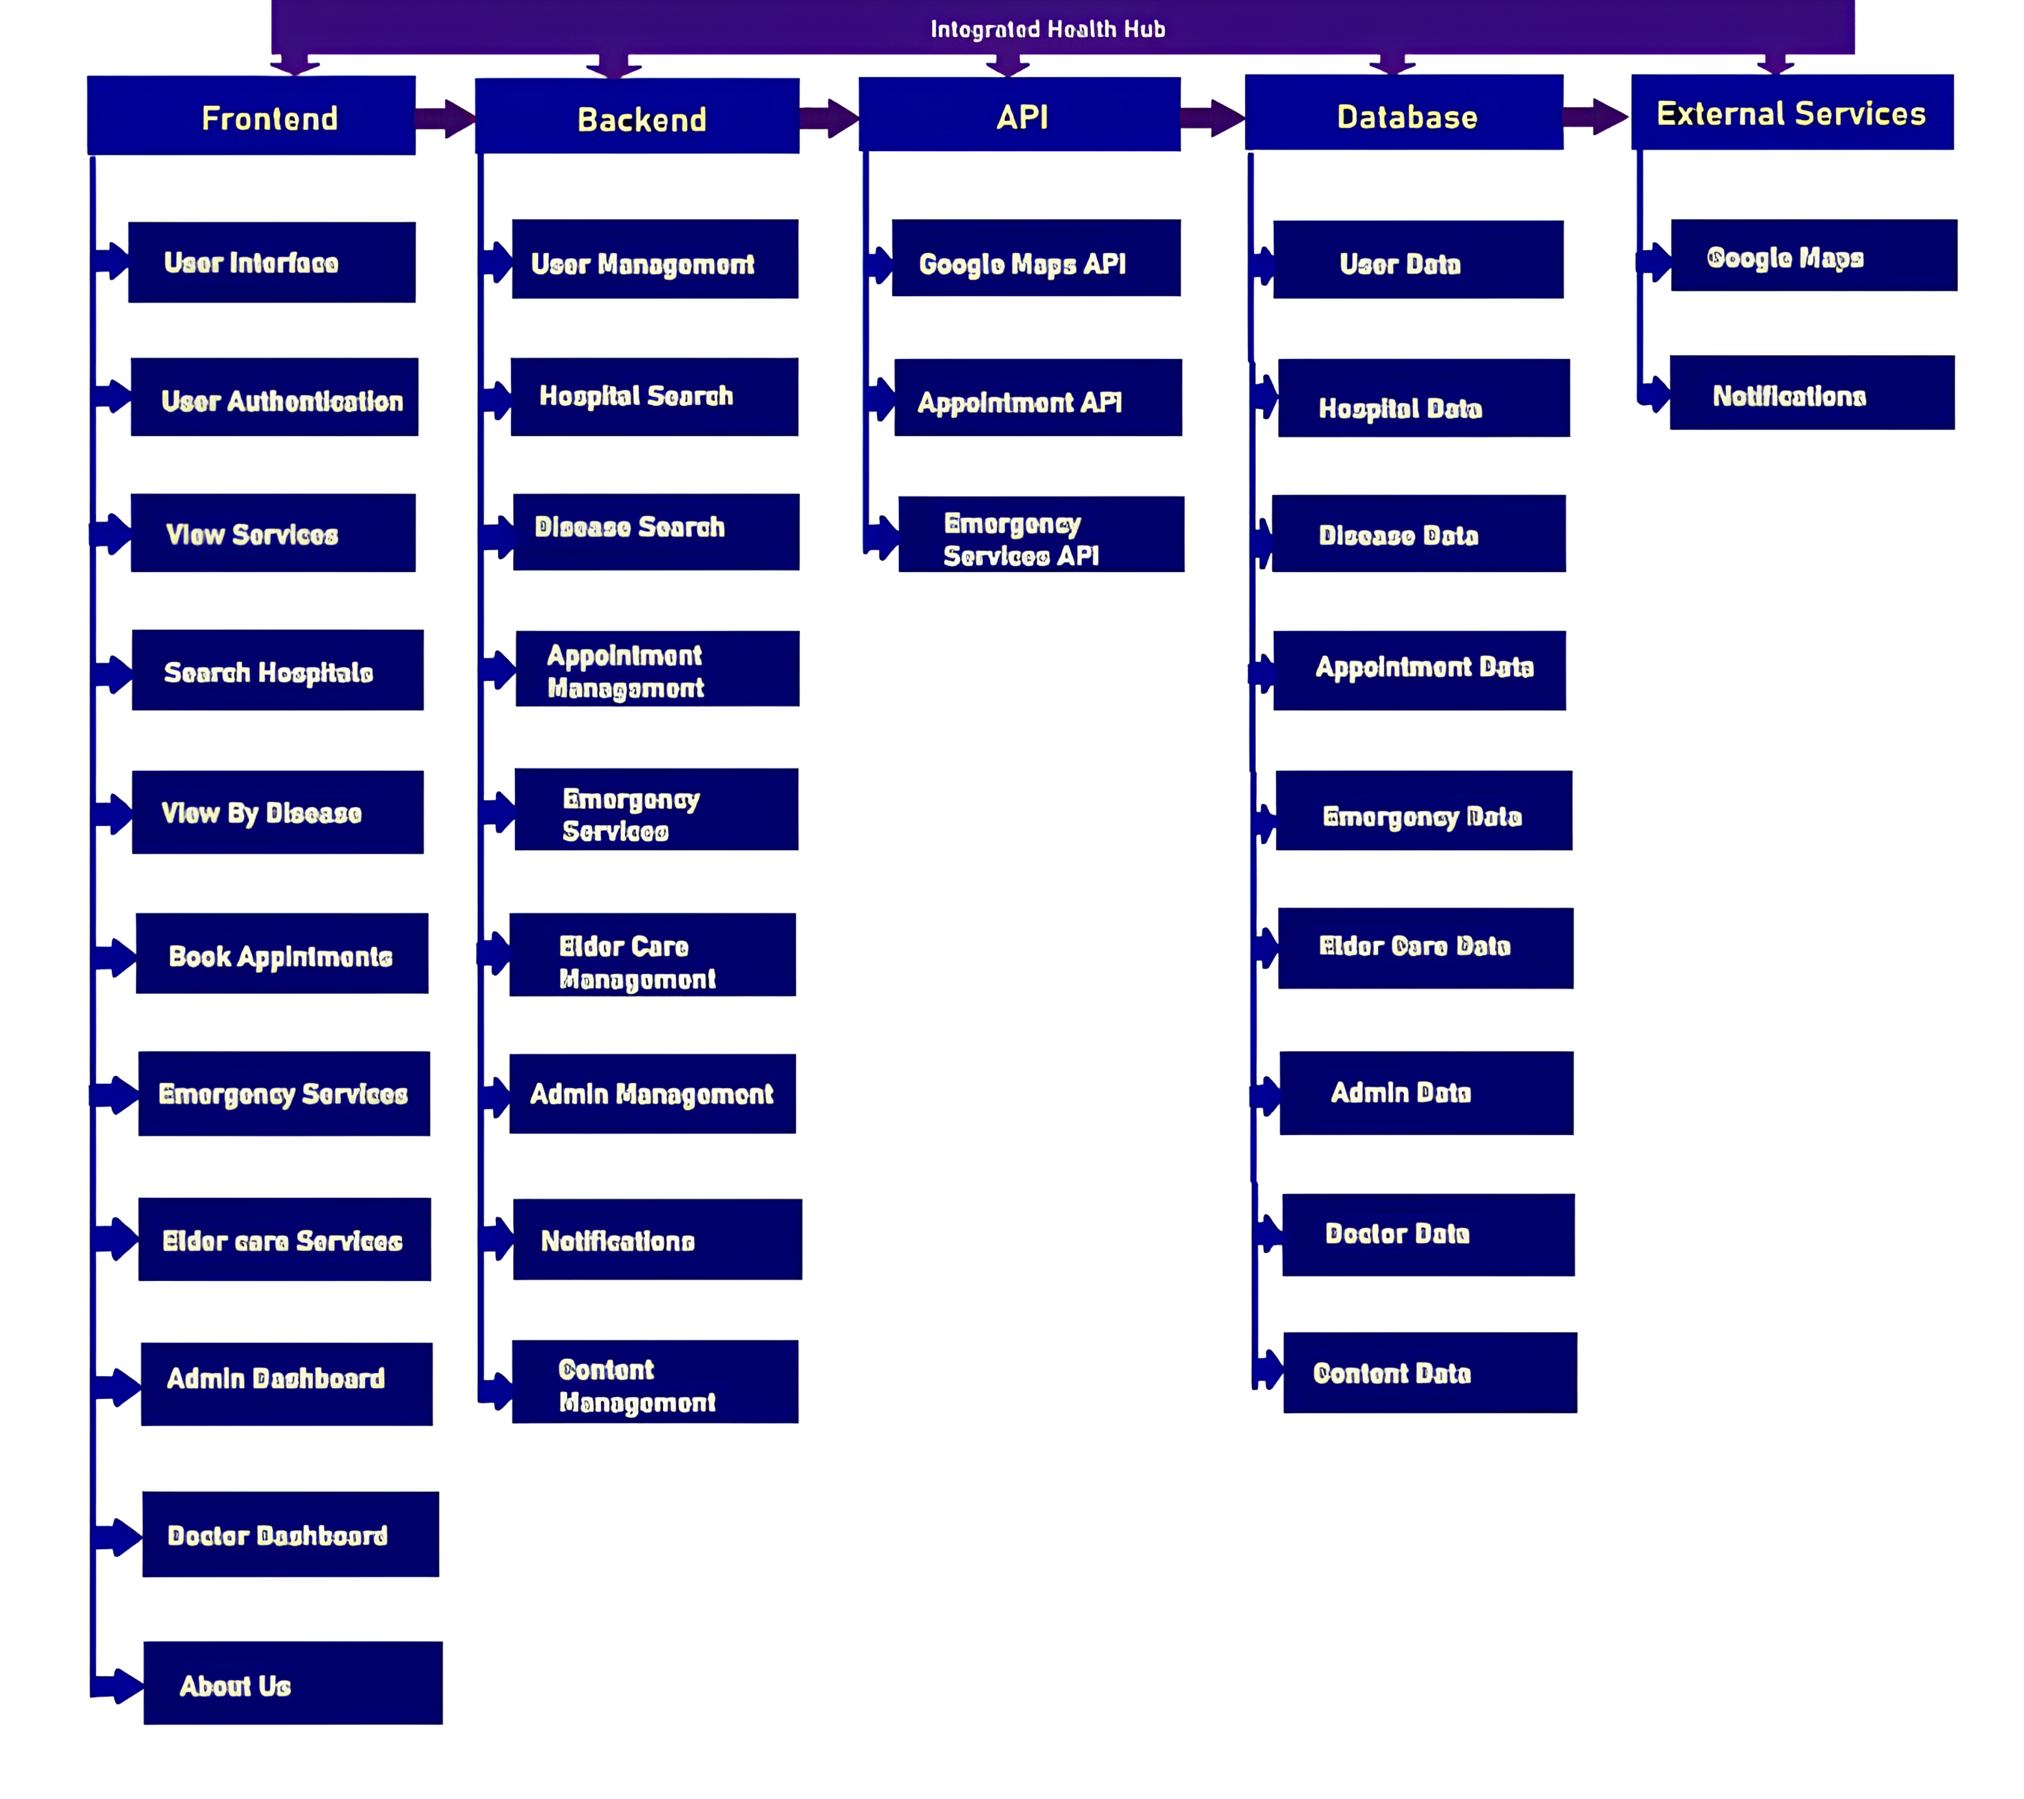
Architecture Diagram
Fig 2. Architecture Diagram

Slide 8
Frontend: User Interface (UI) for searching healthcare providers and viewing results.
Backend: Handles admin and doctor logins, processes searches, and talks to the API.
API: Connects frontend and backend, retrieves provider data from the database.
Database: Stores information on registered providers (doctors, hospitals,services) with details like contact and ratings, address

Slide 9
Technologies Used
Frontend:
HTML: Structures content and layout.
CSS: Controls visual appearance (fonts, colors, styles).
Bootstrap: Enables responsive web design for various screen sizes.
Backend:
Python: Server-side logic (common and easy to read).
Flask: Lightweight web framework for flexible app development.
Database:
MySQL: Stores application data (users, providers, ratings, etc.).
Other Tools:
Client-side Frameworks: Manage dynamic components and UI behavior (e.g., PHP, Python).
UI Component Libraries: Pre-built UI components (e.g., Material UI, Bootstrap) for faster development and consistent design.
Data Access Libraries: Simplify data interaction with the database (e.g., SQLAlchemy for Python).
Security Libraries: Protect user information and prevent unauthorized access (e.g., password hashing).

Slide 10
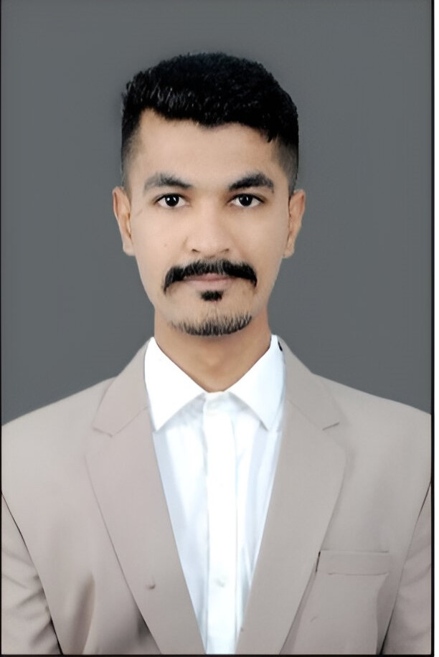
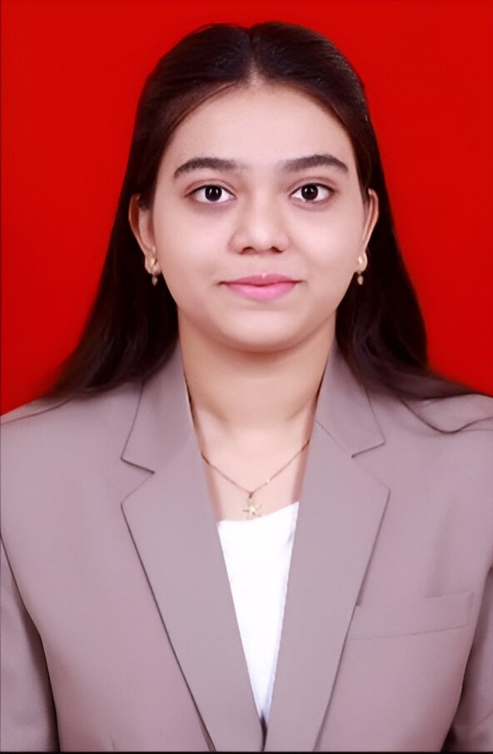
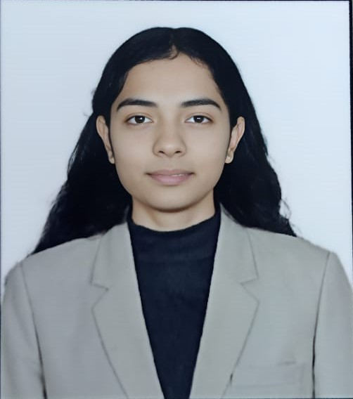
Team Members and Contribution
Sujal Guhe
Mrunali Yawale
Samiksha More

Slide 11
To build the Integrated Health Hub, a team with skills in crafting user interfaces HTML, CSS, JavaScript and handling server-side logic Python, Flask is needed, along with database knowledge MySQL.
Sujal Guhe, UI Designer and Team Lead:
Provides that the project satisfies user needs and remains on time.
Creates an intuitive and user-friendly web application interface.
Emphasizes user experience, usability, and accessibility.
Data analysts examine medical data to glean insights and enhance search engine optimization.
2) Murali Yawale, The Front-End Developer:
Used HTML, CSS and JS for this web-based application.
Integrates collecting information and display with backend APIs. (NearMe API)
Provides cross-browser compatibility and responsiveness.
Produces simple and understandable material for the application’s website.
3) Samiksha More, Back-End Developer:
Creates the application's server-side functionality.
Puts in place APIs for data transmission and user interaction.
Uses an encrypted database to control the storage and retrieval of data.

Slide 12
Conclusion
Simplified access: One app replaces endless internet searches.
Decision-making support: Doctor ratings, lab/hospital/pharmacy finds.
Cost awareness: Information about costs and insurance coverage.
Holistic healthcare: Includes emergency services, eldercare, nurses.
Adaptability: Continuously improves based on user feedback.
Empowerment through knowledge: Provides patients with the information they need to confidently manage their health.

